Slide 1
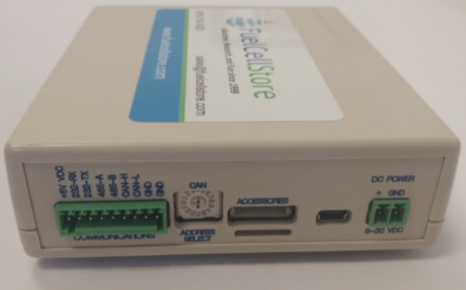
Team 36:
Fuel Cell Monitor
Final Presentation
Nolan Kao
Mingoo Jung
John Henderson
TA: Max Lesser
Sponsor: John Lusher

Slide 2
System Overview
The Fuel Cell Monitor (FCM) will be able to monitor up to sixteen cell voltages simultaneously and display them on a mobile application.

Slide 3
System-Level Requirements
Able to read sixteen separate voltages on a mobile application through Bluetooth
Able to read voltages from -2V to 2V
1-kV isolation of Voltage Sensor Array from all other systems
Voltage sampling rate of 100 Hz

Slide 4
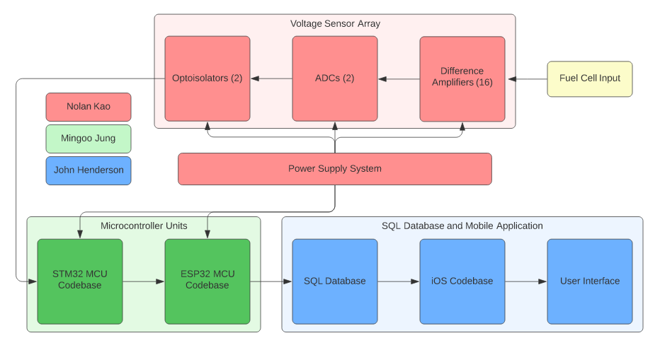
FCM System Diagram

Slide 5
Power Supply / Voltage Sensor Array (VSA) Characteristics
Wall plug delivers 5VDC to power supply.
Power supply delivers 5VDC to sixteen difference amplifiers and two ADCs in VSA.
Power supply delivers 3.3VDC to 2 optoisolators, STM32 MCU, and ESP32 MCU in VSA.

Slide 6
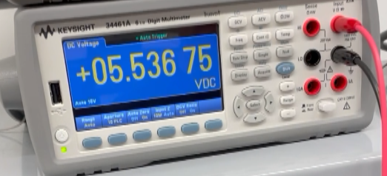
Power Supply Results
Expected voltage: 5.1V
Actual voltage: 5.53V to 5.54V
For full video, check out this link:
https://www.youtube.com/watch?v=ngk329EGncc

Slide 7
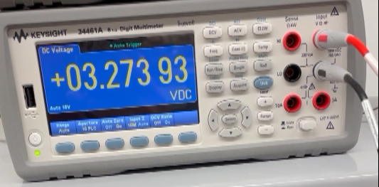
Power Supply Results (continued)
Expected voltage: 3.3V
Actual voltage: 3.26V to 3.3V
For full video, check out this link:
https://www.youtube.com/watch?v=_JLexcVf-Ao

Slide 8
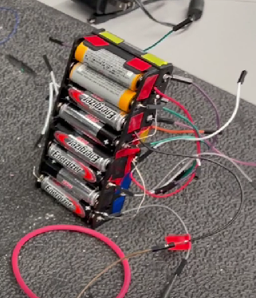
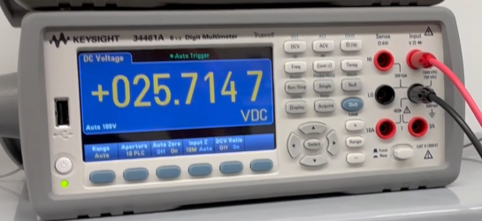
VSA Results
Validated with mock fuel cell stack (sixteen 1.5V batteries, one to each port)

Slide 9
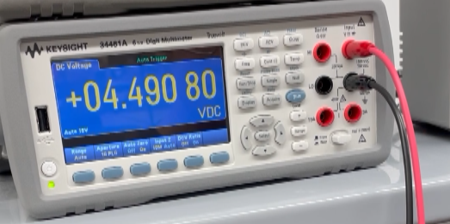
VSA Results (continued)
Output range is between 4.47V and 4.50V as expected.
Bias voltage: 2.79V
Battery voltages: 1.58V to 1.60V
For full video, check out this link: https://www.youtube.com/watch?v=vVDM57WZ8-Q

Slide 10
MCU Characteristics
Logic Microcontroller Unit : STM32F401RE
With Serial Peripheral Interface (SPI) gather data from voltage sensor
Stacking voltage data and transmit it to the Communication MCU through SPI
Communication Microcontroller Unit: ESP32-WROOM-32D
Receiving voltage data from the Logic MCU and stacking it in one packet
Send a data packet through Bluetooth (BLE) characteristic

Slide 11
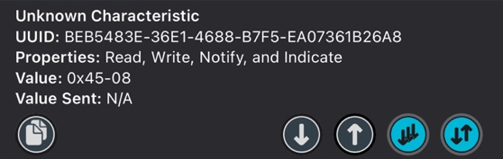
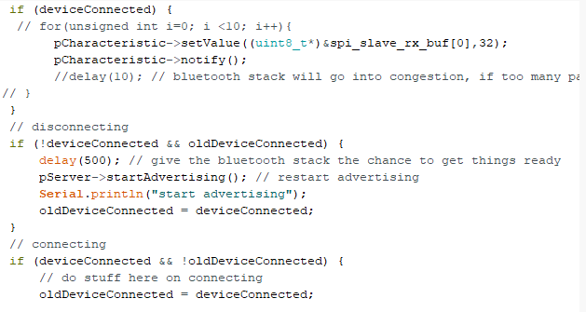
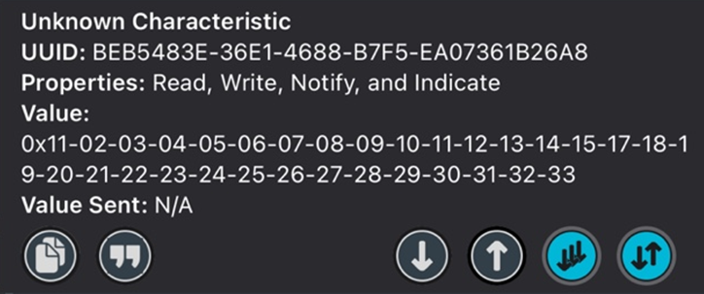
MCU Communication Result
Figure1-1. Transmit voltage data separately with loop (before modifying)
Figure2. Modified code for transmitting data
Figure1-2. Transmit 16 voltage values in a packet

Slide 12
Mobile App Characteristics
Connects to MCU through BLE
Stores all readings into a SQL database’
User Interface includes:
Title screen to connect and indicate if sensor is connected
1 Bar Graph to display last values in database
16 Line Graphs to display each battery’s readings in the last minute

Slide 13
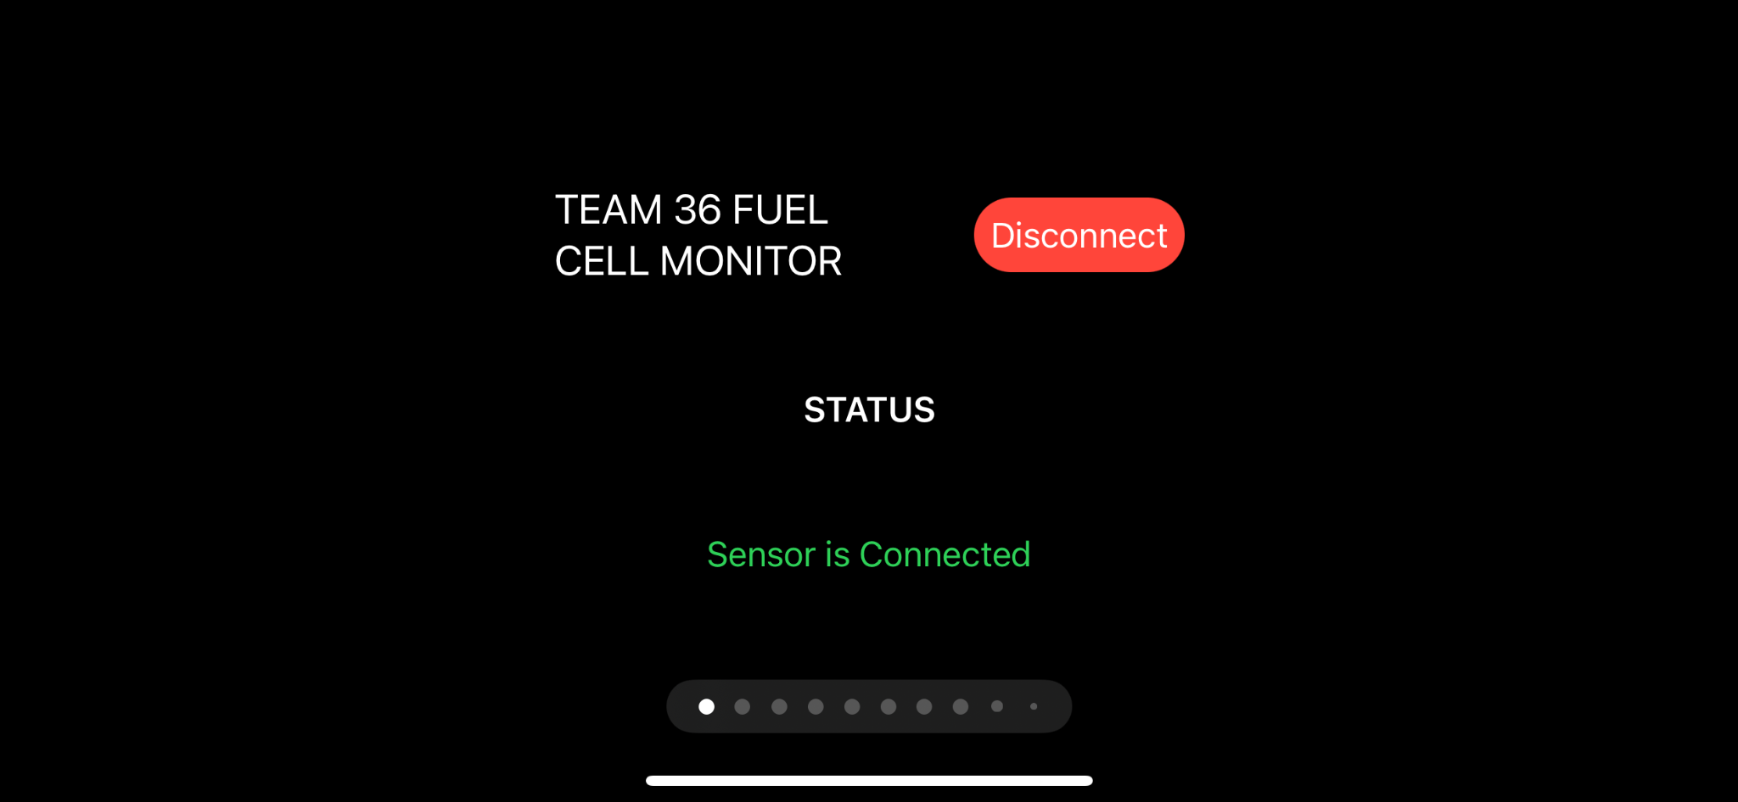
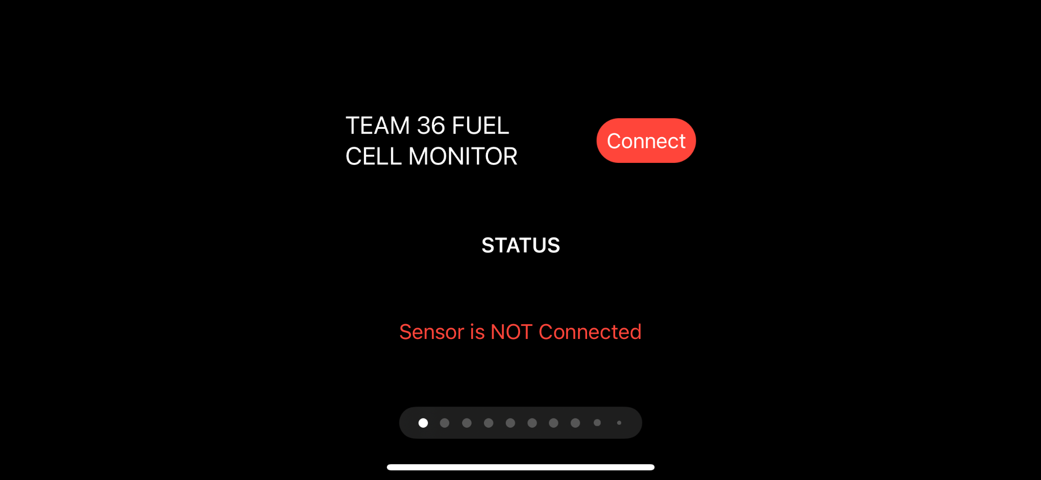

Slide 14
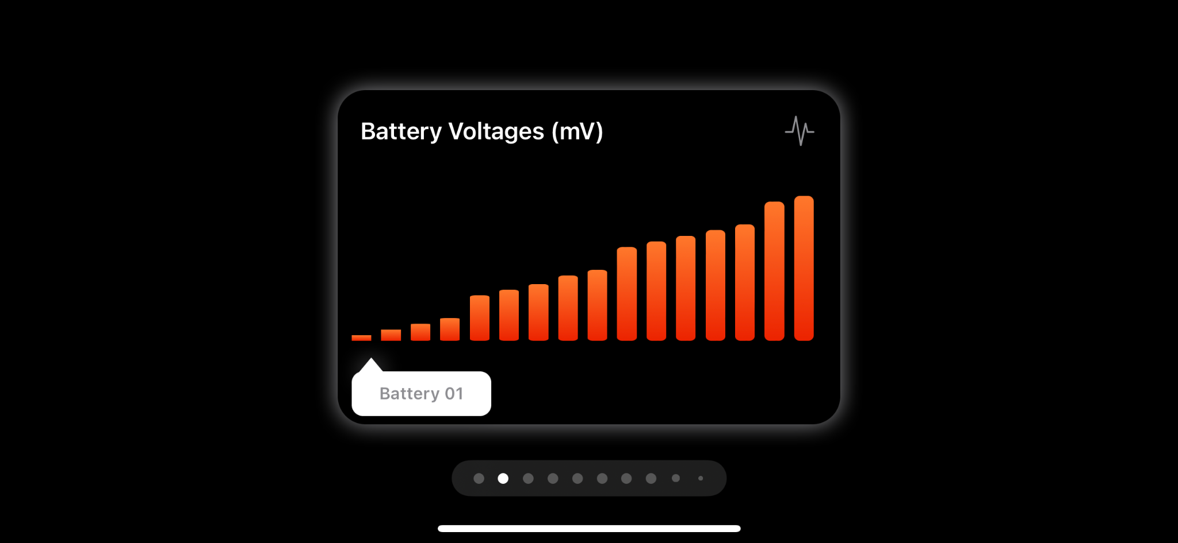
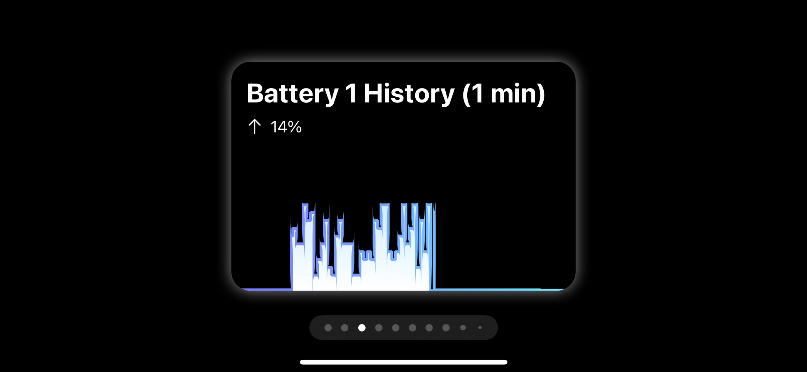

Slide 15
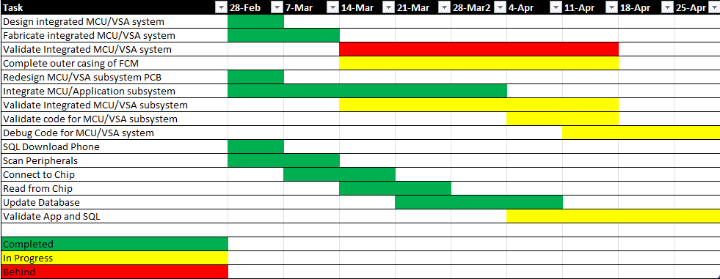
Schedule

Slide 16
Conclusion
PCB design accommodated all components in system. However, oversimplification of initial schematics caused many modifications to the PCB post-fabrication.
Isolation voltage threshold met by component specification in their respective datasheets.
There were 3 times of modifications of code for bluetooth communication. This was because, it was hard to find the most effective way to transmit data.

Slide 17
Project Mitigation
Implement push buttons for MCU boot mode selections
Resume validation with sensor-MCU connectivity
After validation with sensor-MCU connectivity, upload code for each MCU and validate with debugging code
Housing case for the Fuel cell system

Slide 18
Thanks for listening!

